Slide 1


CLINICAL SYMPTOMS DETECTION
C
RONA
VIRUS
VIRUS DESTROYERS
VIRUS DESTROYERS

Slide 2
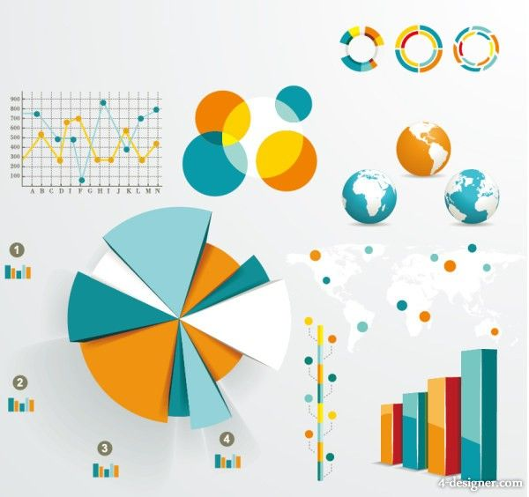
DATA
VISUALIZATION

Slide 3
Data Visualization
Data visualization is the discipline of trying to understand data by placing it in a visual context so that patterns , trends and correlations that might not otherwise be detected can be exposed.
It refers to techniques used to communicate insights from data through visual representation. Its main goal is to distill large datasets into visual graphics to allow for easy understanding of complex relationships within the data. It is often used interchangeably with terms such as information graphics, statistical graphics, and information visualization.

Slide 4
Features of COVID_19
Age
Body Temperature
Dry Cough
Sore Throat
Weakness
Breathing Problem
Drowsiness
Pain in Chest
Travel history to infected countries
Diabetes
Heart disease
Lung disease
Reduced immunity
Symptoms progressed
High blood pressure
Kidney disease
Change in appetite
Loss of sense of smell

Slide 5
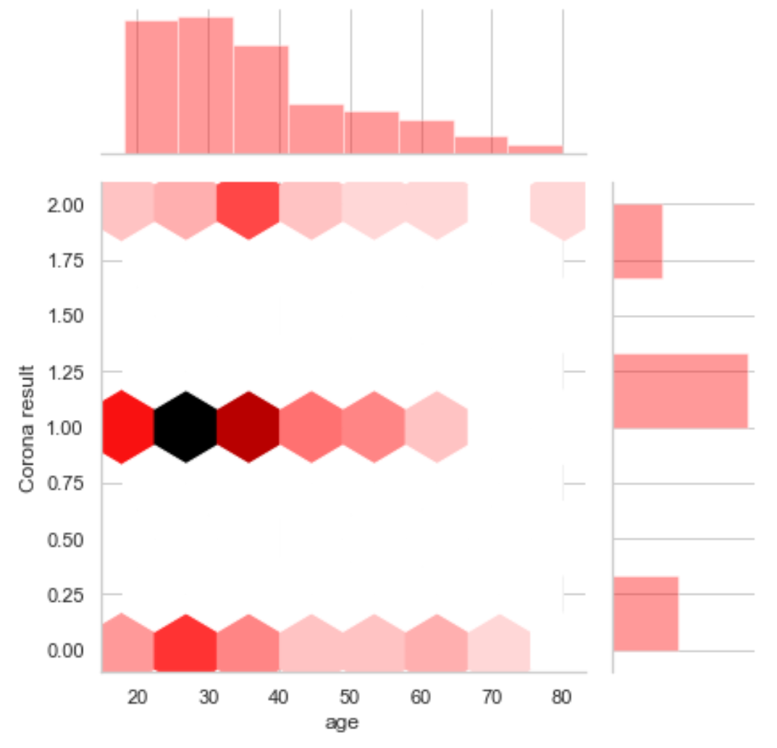
Age significantly determines the clinical features and prognosis of the disease. They are worse in patients older than 60 years and so this jointplot graph of hex kind shows that the old-age people have higher chances of being infected from coronavirus.
Why we use Age as a feature?

Slide 6
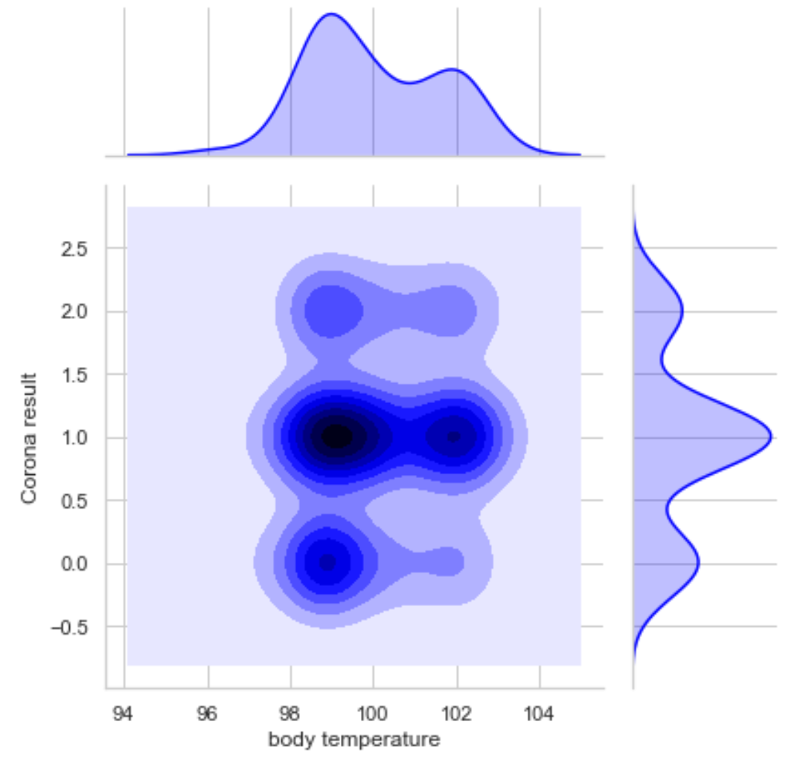
The joint plot graph of kde kind shows that people with body temperature in the range of 98 to 102 have higher chances of infected from corona.
Why we use body temperature as a feature?

Slide 7
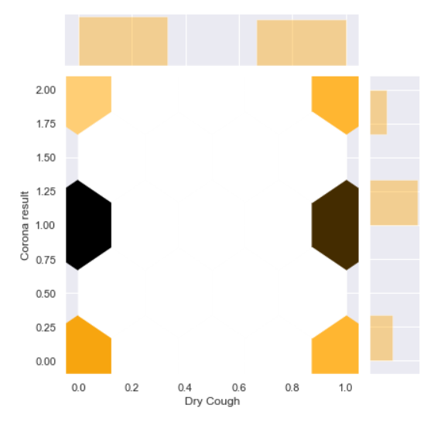
Why we use dry cough as a feature?
The dry cough is the one where no mucus or phlegm is produced with the cough and by this jointplot graph of hex kind it is clear that the people who have dry cough will get higher probability of suffering from corona.

Slide 8
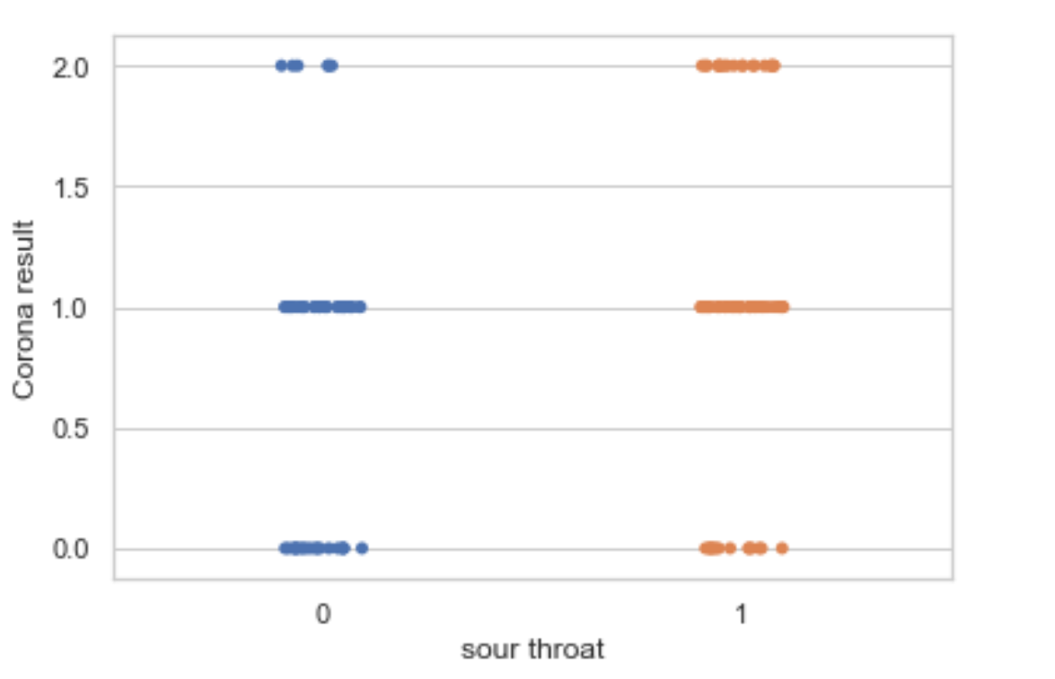
Why we use use sour throat as our feature ?
As it is clear that, this stripplot graph shows sour throat lies in 1.0 and 2.0 range, so those people have higher chances of infected from coronavirus.

Slide 9
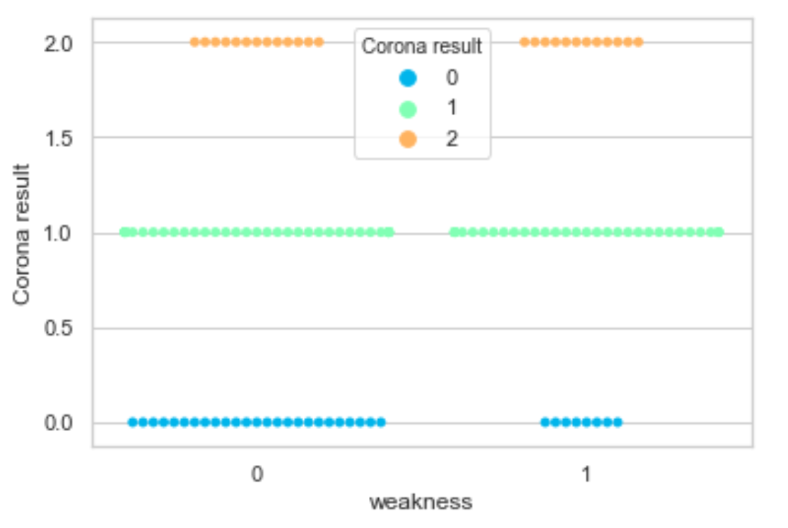
Why we use weakness as a feature ?
We are not strong enough to tolerate what is harmful to our body and so it is clear from swarmplot graph that the people who have weakness will get a higher chance of corona results to be positive.

Slide 10
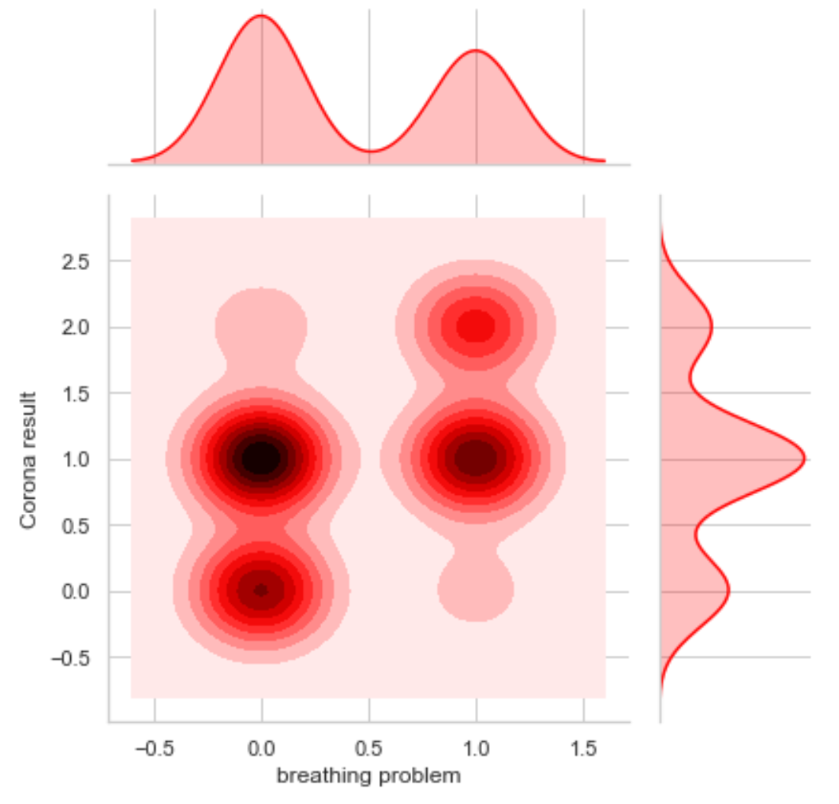
Why we use breathing problem as our feature ?
As this jointplot graph of kde kind shows that the people lies mainly at 1.0 level so, people who have breathing problem will be suffered from corona.

Slide 11
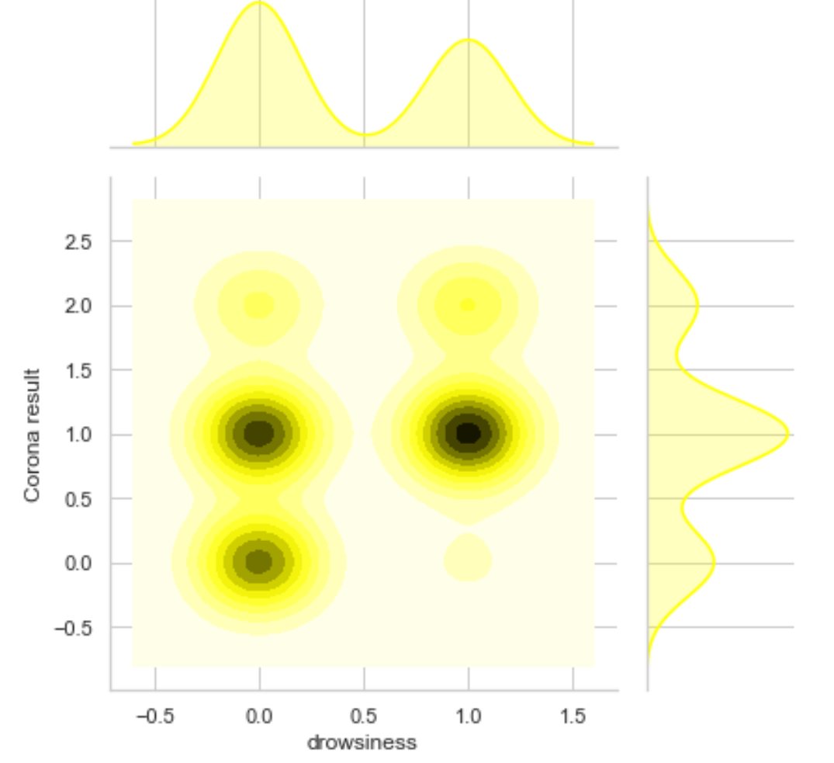
Why we use drowsiness as our feature ?
This jointplot graph of kde kind shows that the people having drowsiness have higher chance of infected from corona.

Slide 12
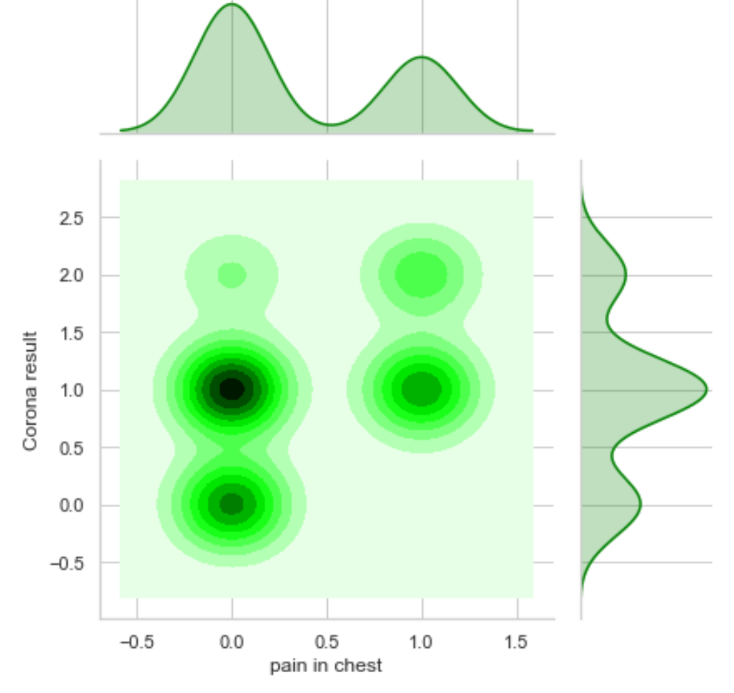
Why we use pain in chest as our feature?
This jointplot graph of kde kind clearly shows that the people having pain in chest mainly lies at 1.0 level so have a probability of suffering from corona.

Slide 13
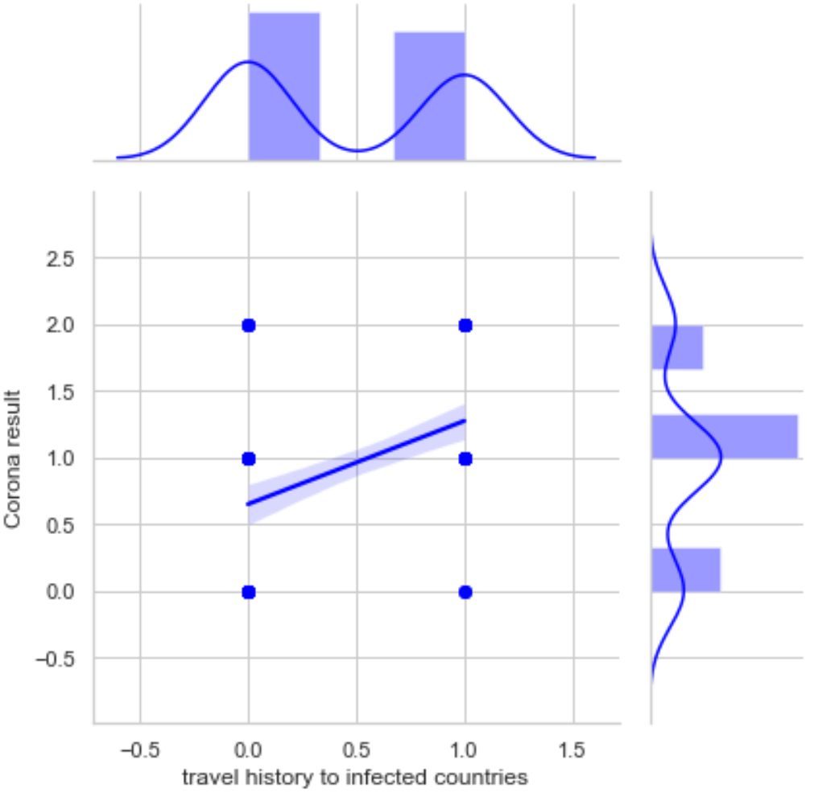
Why we use travel history as a feature?
As the virus spread from gathering in crowds and if we come in contact with people suffering from corona , so this jointplot graph of reg kind shows that travel history plays a great role in the prediction of corona disease.

Slide 14
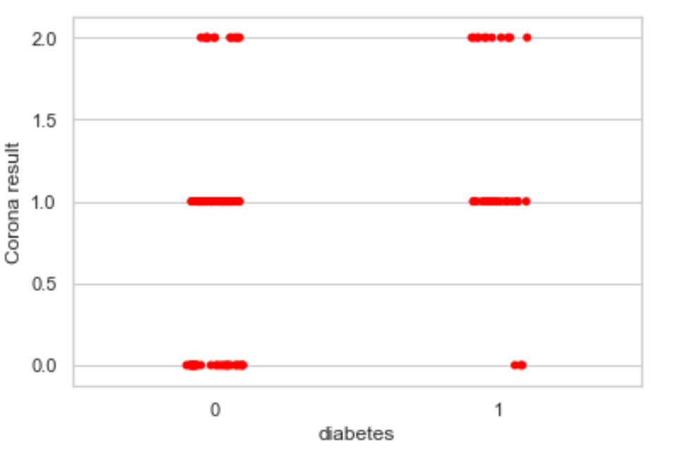
Why we use diabetes as our feature ?
As it is clear from this stripplot graph that the people have higher diabetes rate were more likely to have serious complication and so to die from coronavirus.

Slide 15
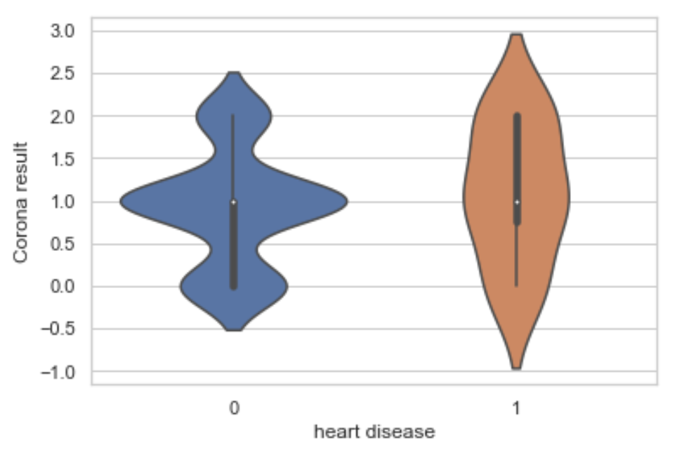
Why we use heart disease as our feature ?
From this violin plot graph the people having heart disease, the spread of corona is the worry for those people and would suffer from corona.

Slide 16
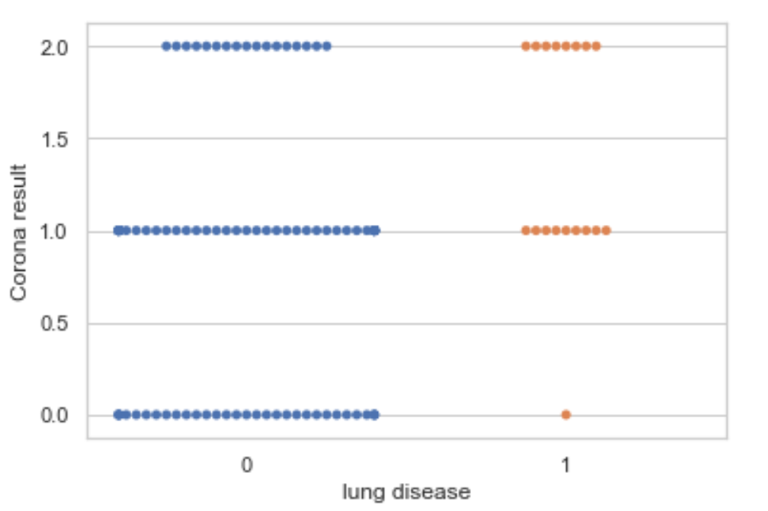
Why we use lung disease as a feature?
As it is clear from this swarmplot graph that the people who have lung disease cause lasting lung damage and so have a high chance of suffering from corona.

Slide 17
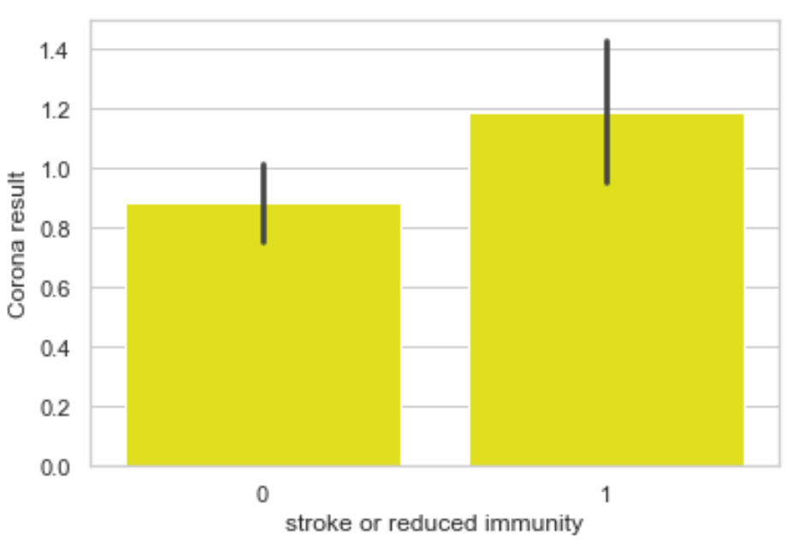
Why we use reduced immunity as a feature ?
The development of immunity through the corona virus shows immediate response and we see in this barplot graph that the people having higher chances of infected from corona.

Slide 18
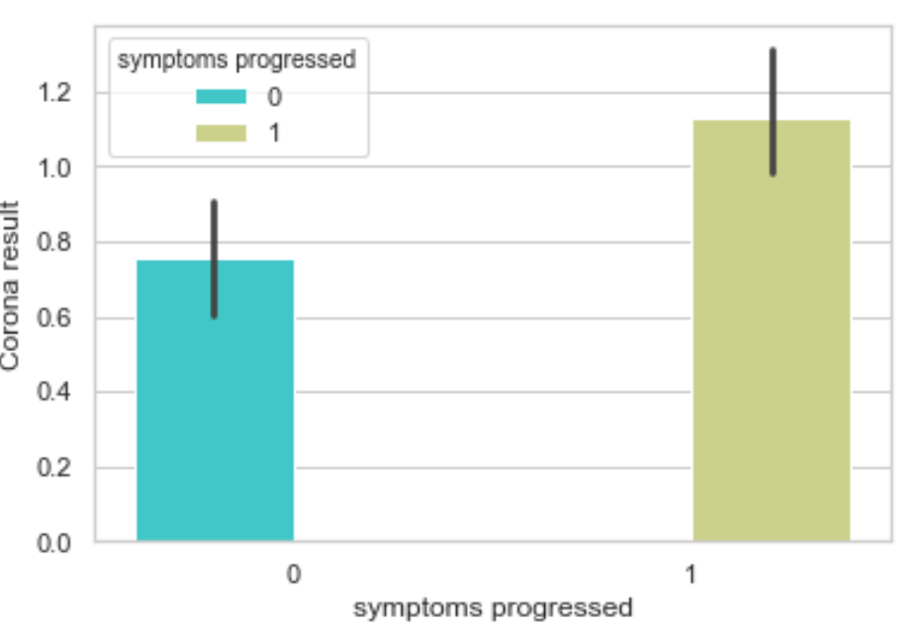
Why we use symptoms progressed as a feature?
Symptoms progressed is an important feature to go more close from corona and in this barplot graph people have higher chances of infected from corona.

Slide 19
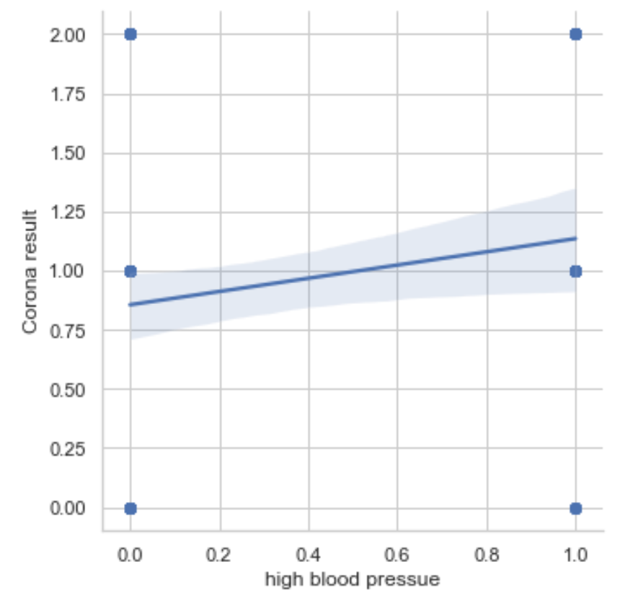
Why we use High blood pressure as a feature?
As it is clear from this lmplot graph that the people who have high blood pressure and so could raise higher risk of experiencing severe complications and so have chances to be infected from corona.

Slide 20
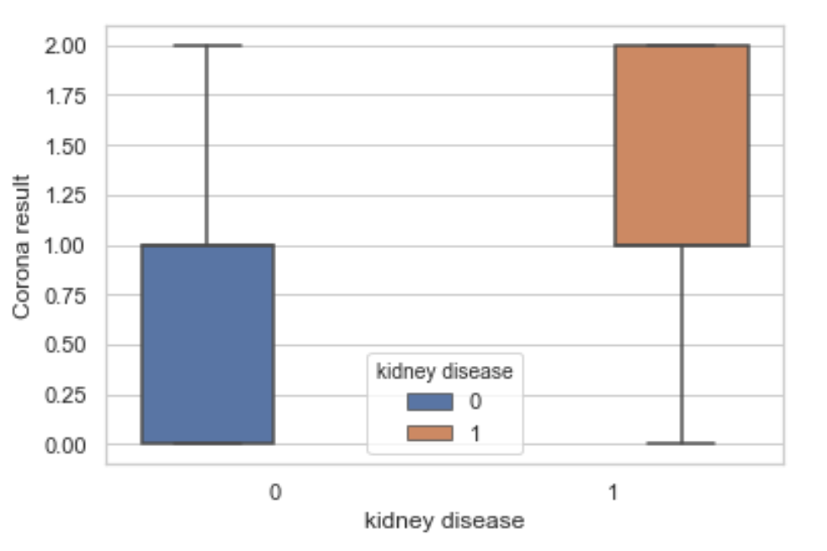
Why we use kidney disease as our feature?
As it is clear from this boxplot graph that the people who have kidney problem has higher probability of suffering from corona and so playing an important feature in the model.

Slide 21
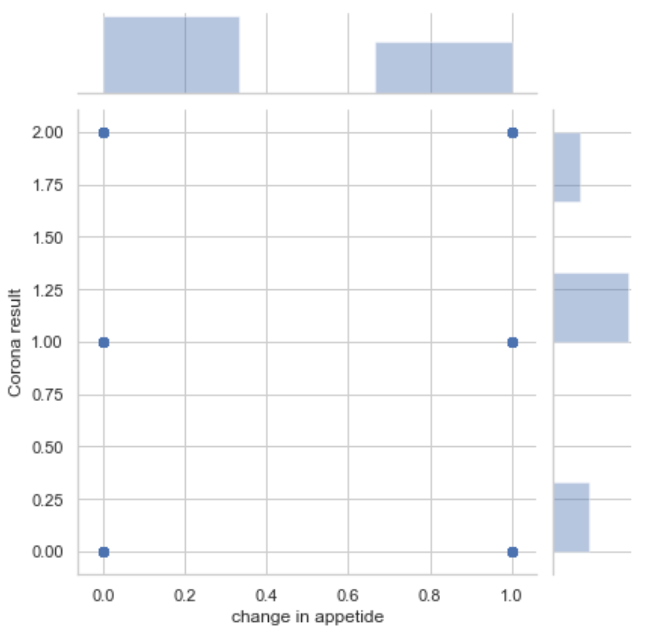
Why we use change in appetite as a feature?
This jointplot graph of scatter kind shows that the people who have change in their appetite including ageing, nervousness and grief so have more chances to be infected from virus.

Slide 22
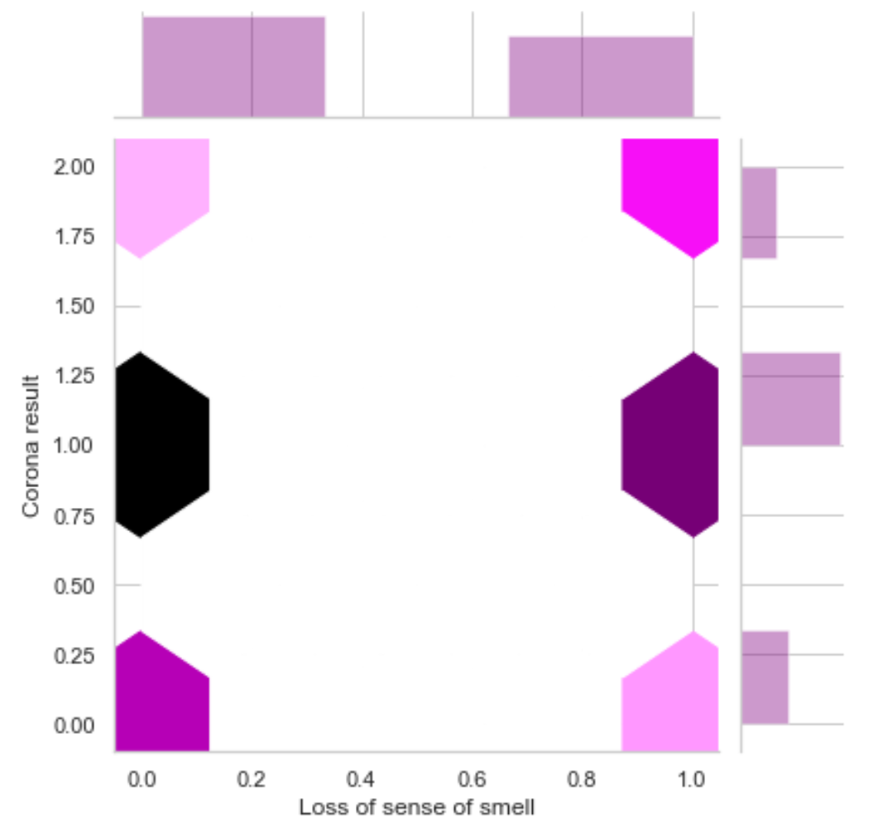
Why we use loss of sense of smell as a feature?
Smell loss can be one of the earliest signs of COVID-19 infection and as the conclusion drawn from this jointplot graph of hex kind that the people who have loss of sense of smell get higher chances of infected from corona.

Slide 23
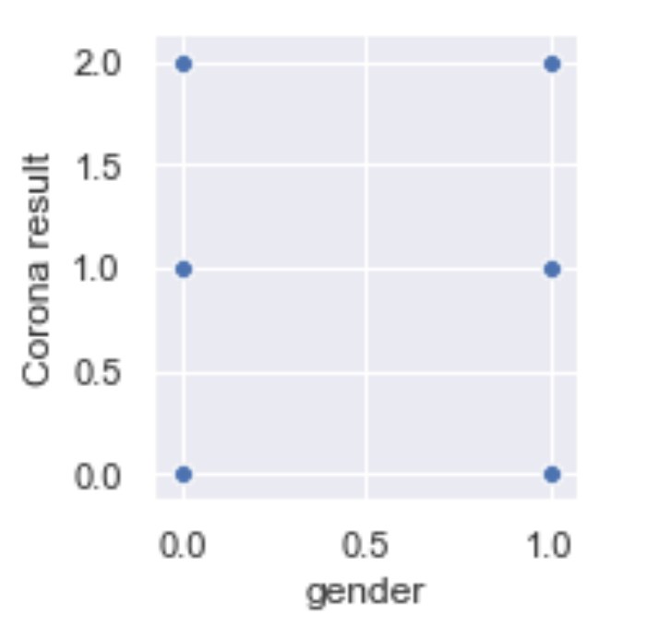
Why we use gender as a feature ?
It is clear from this jointplot graph that both the genders i.e. 0:Male and 1:Female plays an important role in the prediction of corona.

Slide 24
LOGISTIC REGRESSION
for
COVID-19 Detection
(Ist Approach)

Slide 25
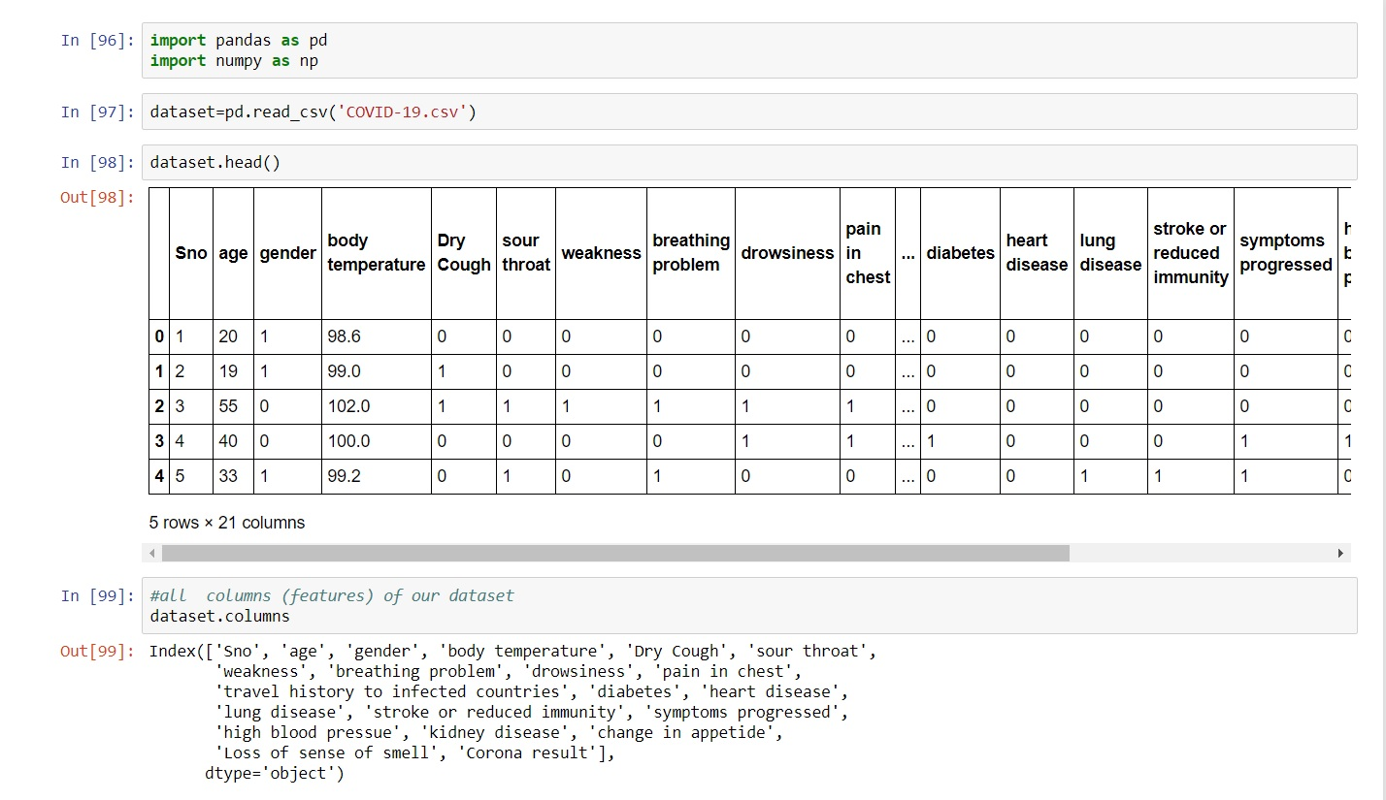
MODEL CREATION

Slide 26
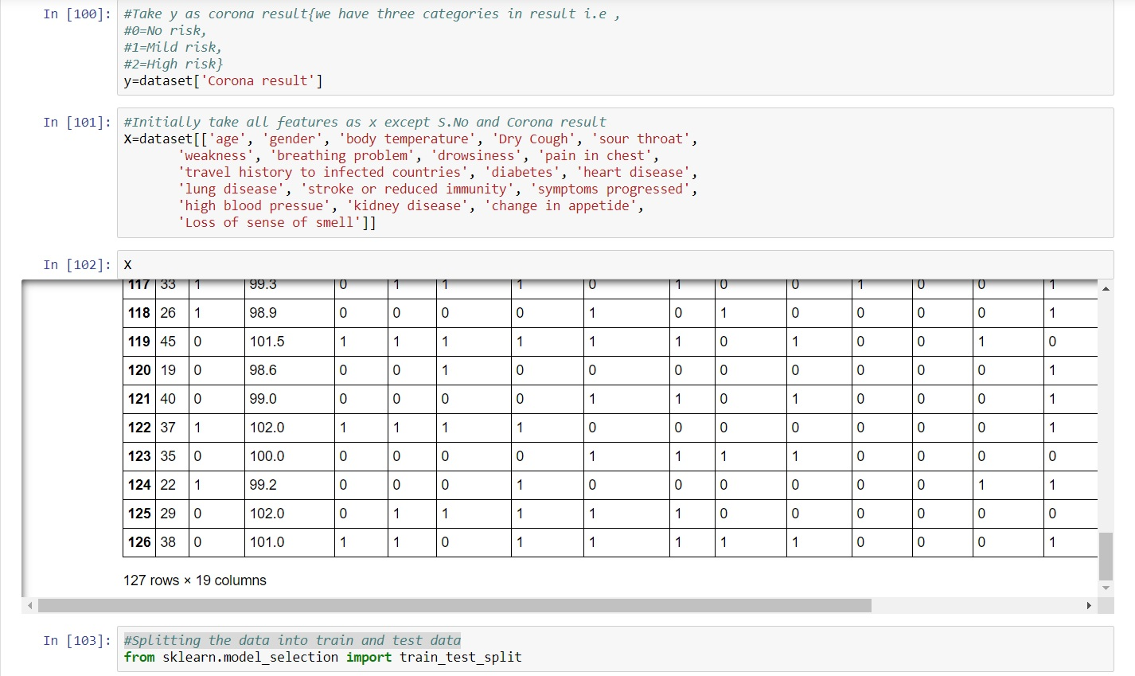
INPUT -COVID-19 DATASET

Slide 27
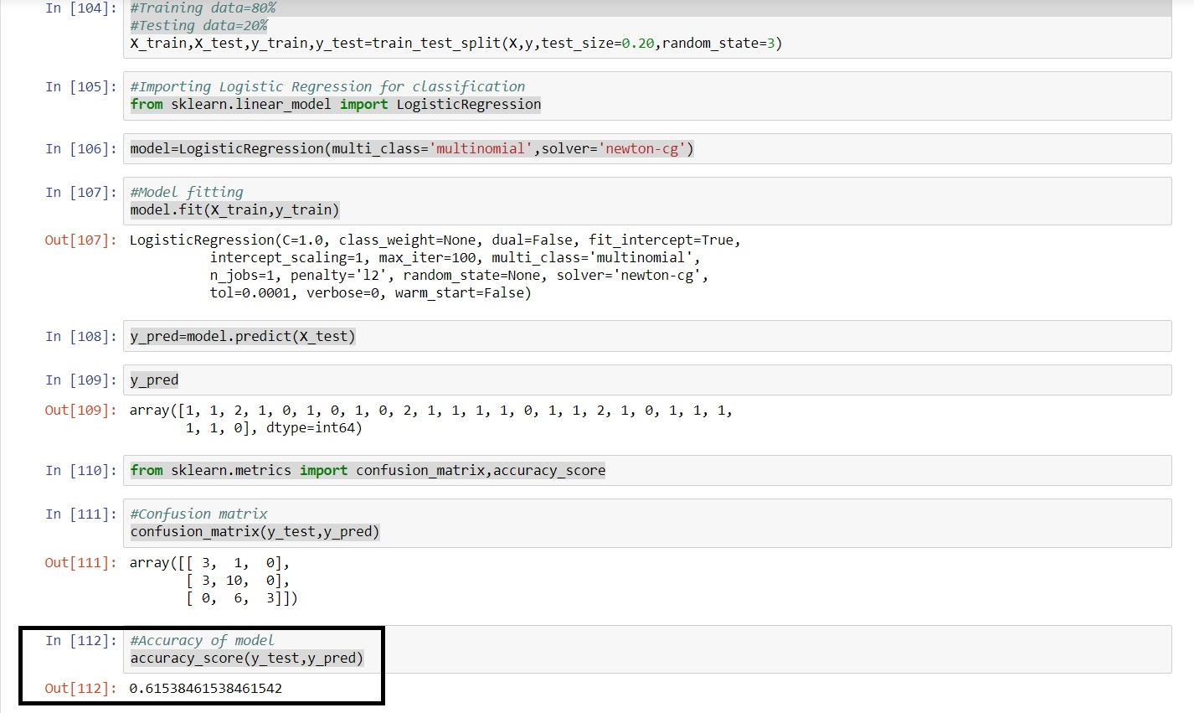
OUTPUT-1

Slide 28
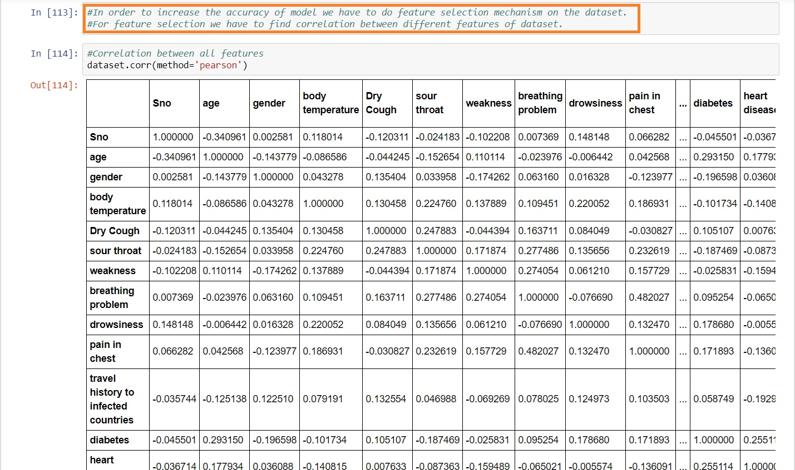
PERFORMING FEATURE SELECTION IN LOGISTIC REGRESSION

Slide 29
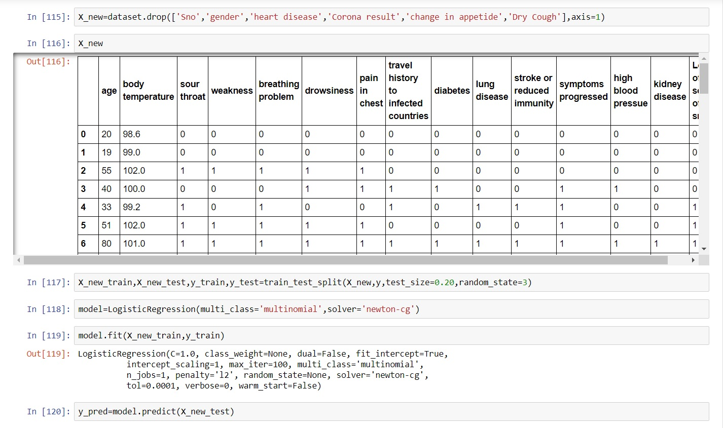
TRAIN THE MODEL

Slide 30
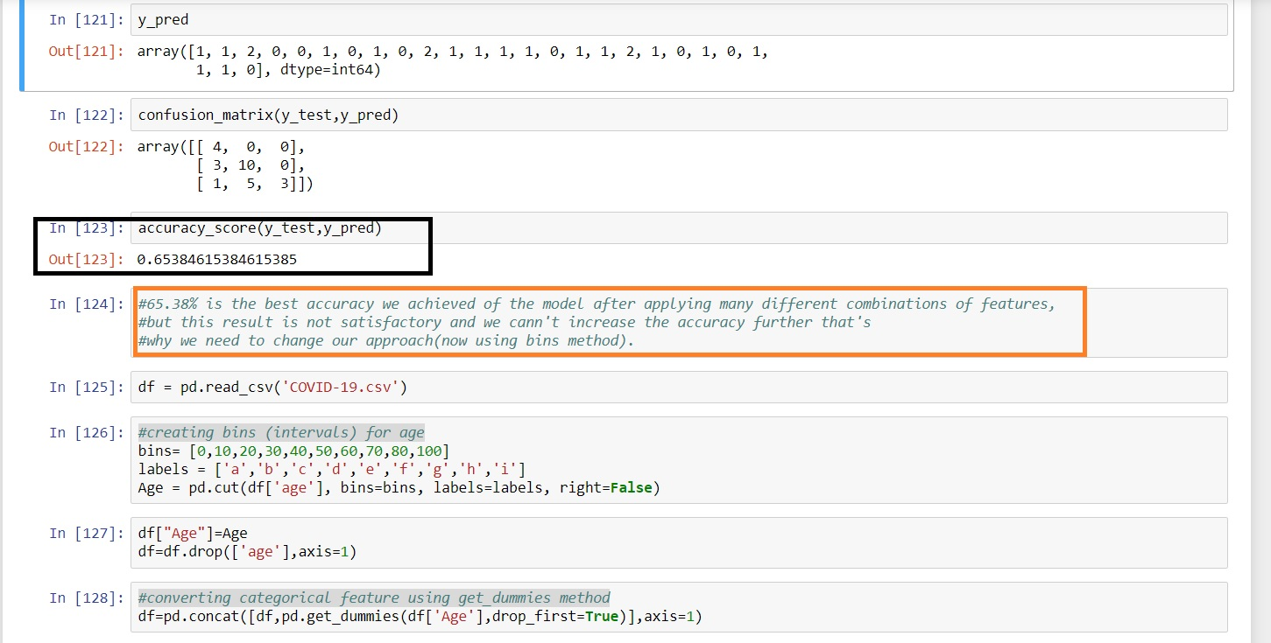
OUTPUT-2

Slide 31
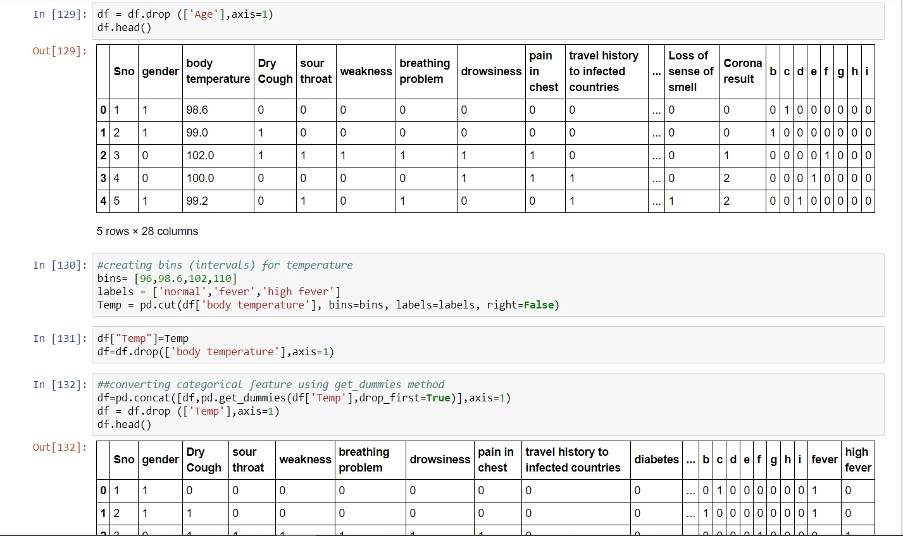
NOW USING BINS

Slide 32
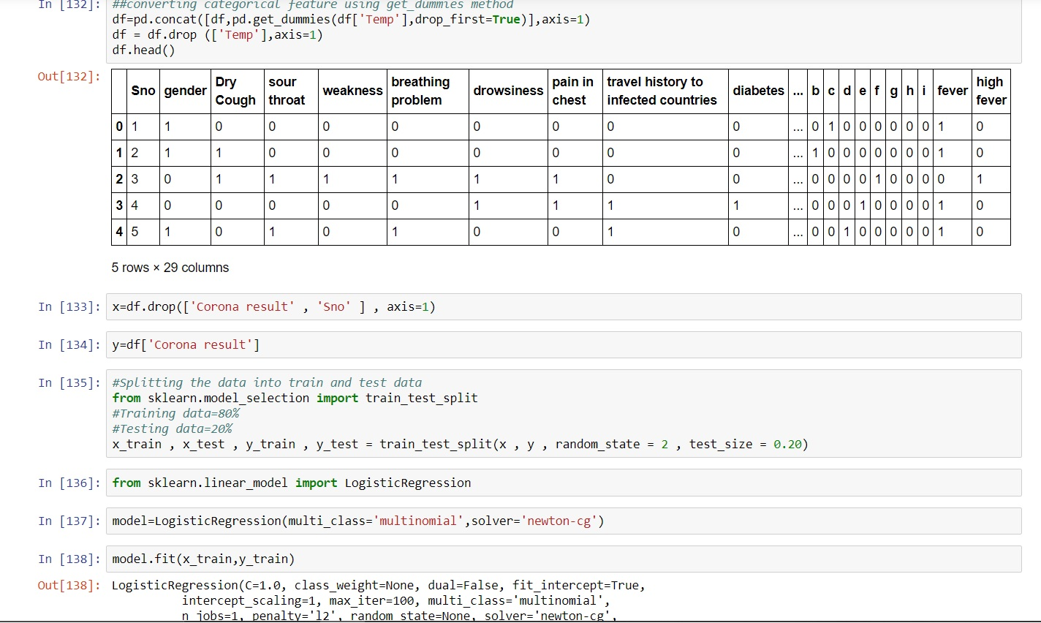
TRAIN THE MODEL

Slide 33
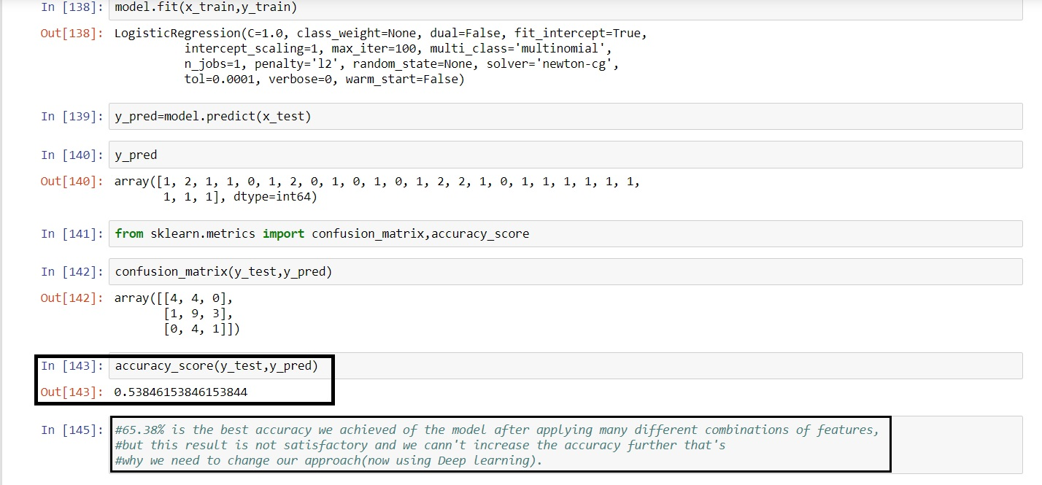
OUTPUT-3

Slide 34
HENCE WE CAN NOT FURTHER INCREASE THE ACCURACY OF THE MODEL(i.e-65.38%) BY USING LOGISTIC REGRESSION THAT’S WHY WE SHIFT TOWARDS DEEP LEARNING.

Slide 35
DL Model
for
COVID-19 Detection
(IInd Approach)

Slide 36
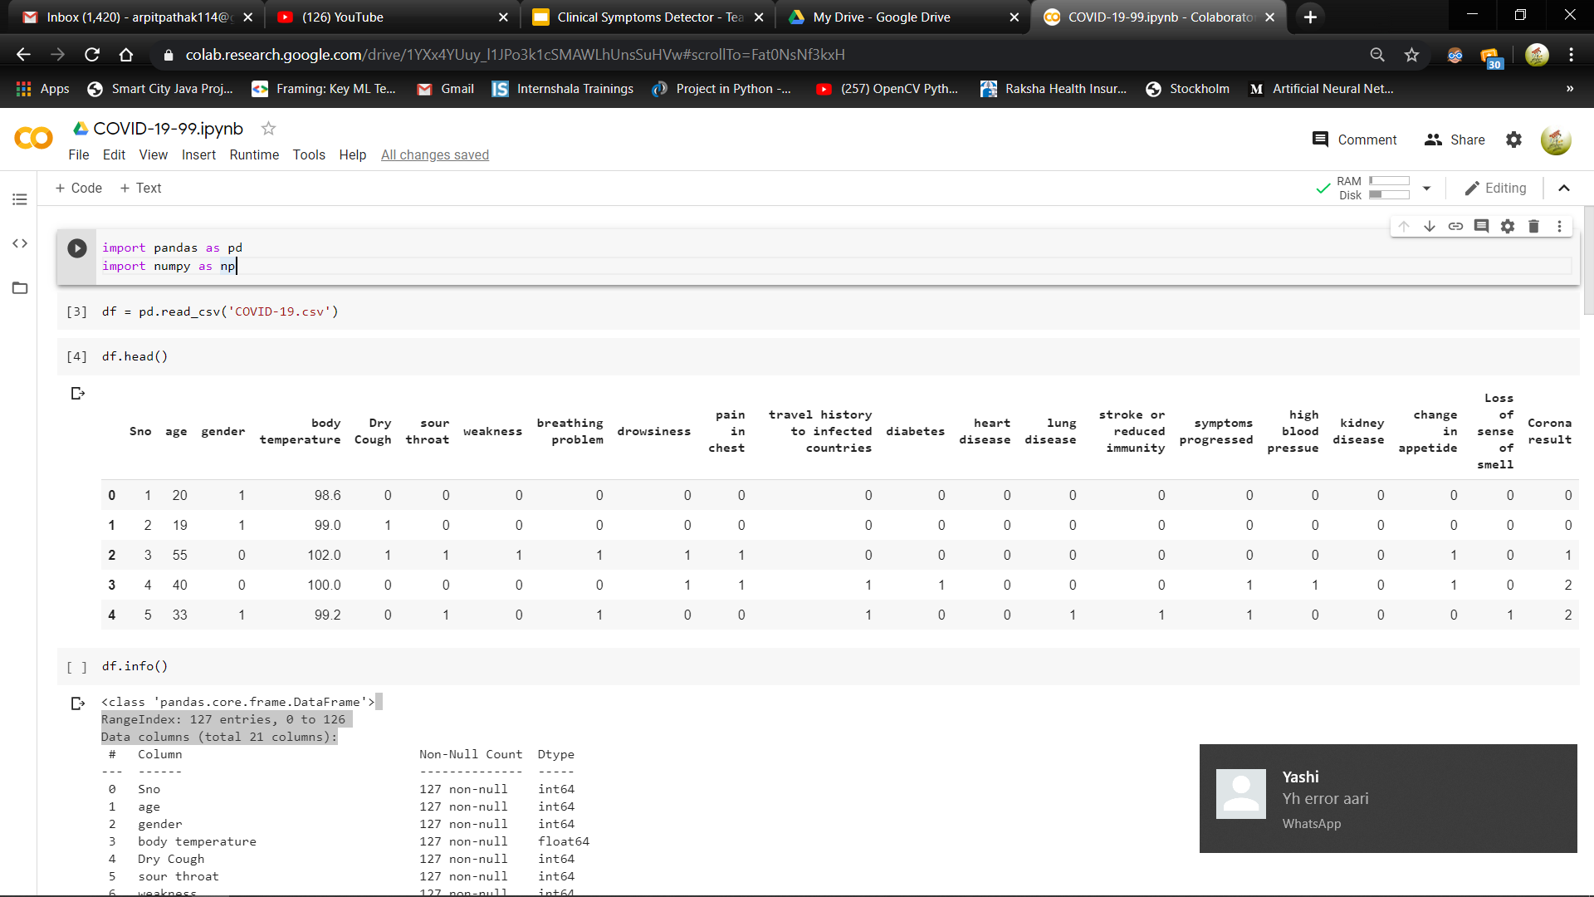
INPUT : COVID-19 Dataset
Fig : Initial Dataset

Slide 37
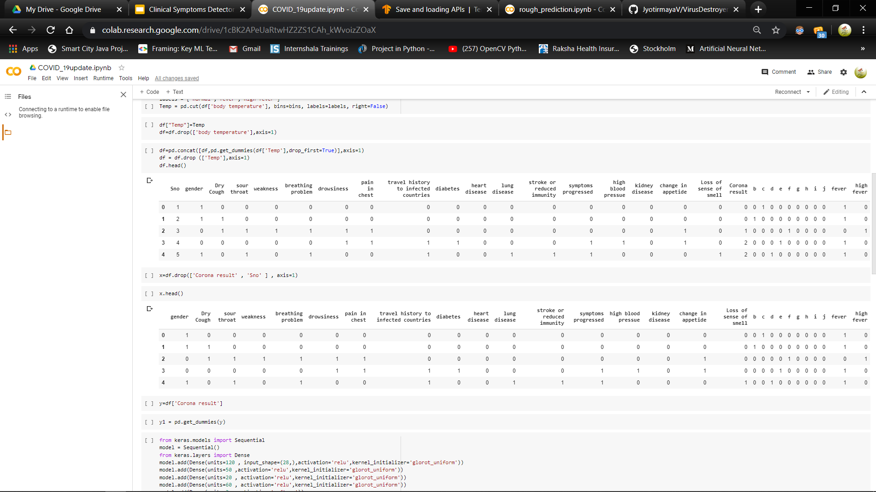
INPUT : COVID-19 Dataset
Fig : Final preprocessed dataset
Age Grouped by :
[ ‘a’:’0-10’ , ‘b’ : ‘10-20’ , ‘c’ : ‘20-30’ , ‘d’ : ‘30-40’ , ‘e’ : ‘40-50’ , ‘f’ : ‘50-60’ , ‘g’ : ‘60-70’ , ‘h’ : ‘70-80’ , ‘i’ : ‘80-100 ’]
Body Temperature Grouped by :
[ ‘normal’ : 96-98.6F , ‘fever’ : 98.6-102F , ‘high fever’ : >102]

Slide 38
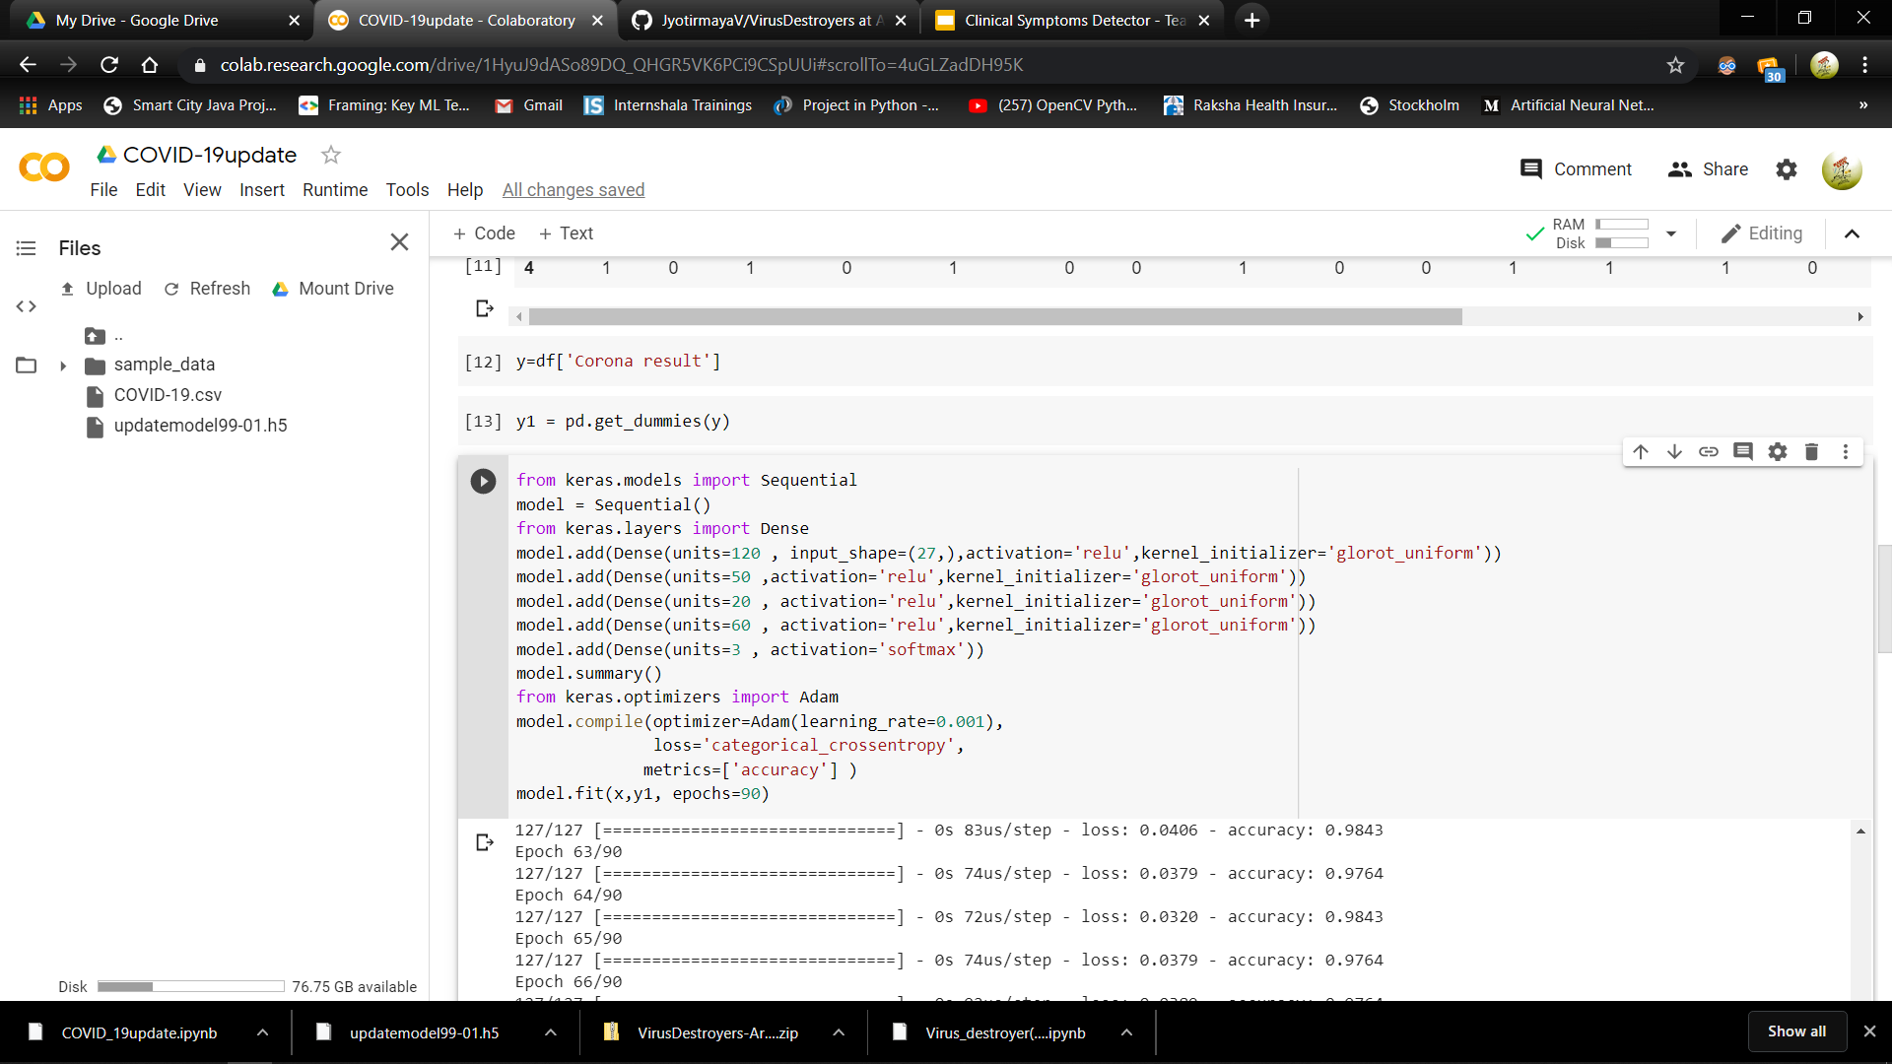
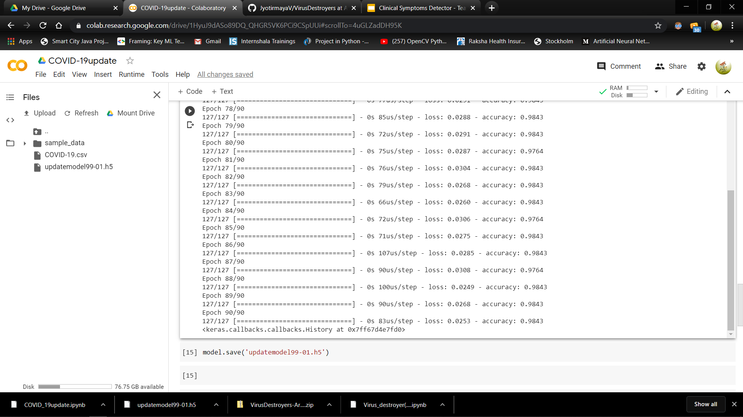
OUTPUT : Final COVID-19 Detection Model
Accuracy=> 98.43%
Loss => 0.0253
Epochs => 90
Hidden Layers => 5
Activation functions ReLU Softmax
Optimizer : Adam
Learning Rate : 0.001
Fig: Final Model and Outcome

Slide 39
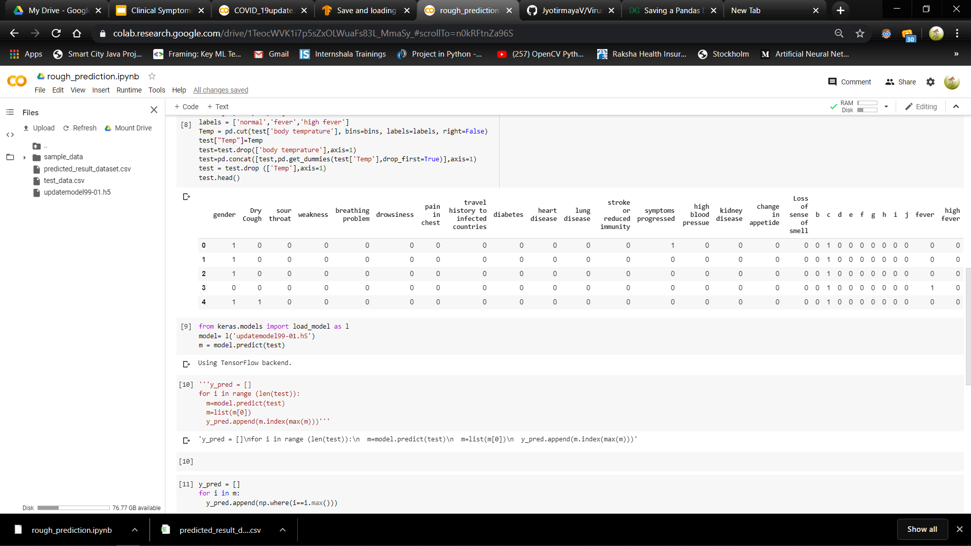
Predicting the data taken from Random people
After training the model over our dataset , a google form was made and sent to some random people to ask them about them about any symptoms , disease and travel history .
(Note : None of these people was/is a corona patient)
This collected data was cleaned and preprocessed to be predicted as follows -

Slide 40
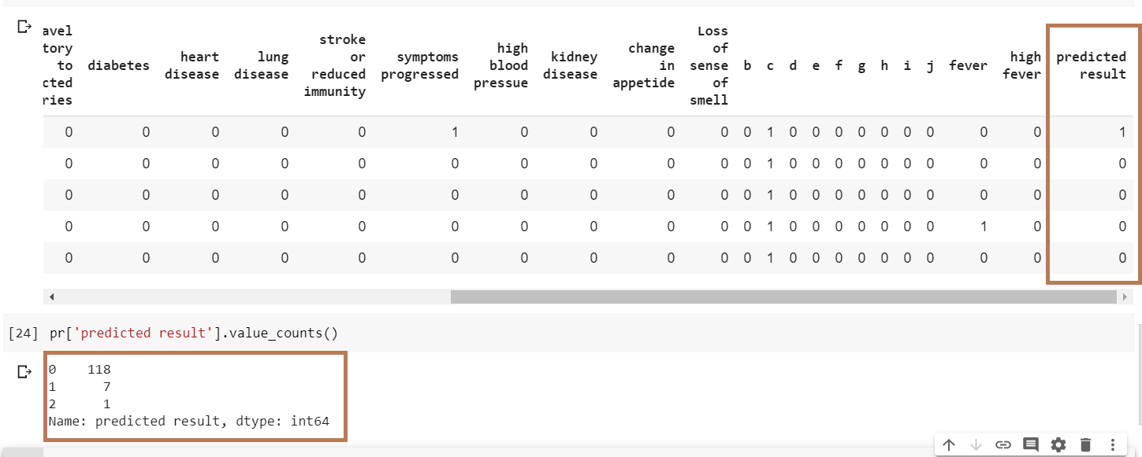
Fig : Predicted results

Slide 41
The Working Model (Website Prototype)

Slide 42
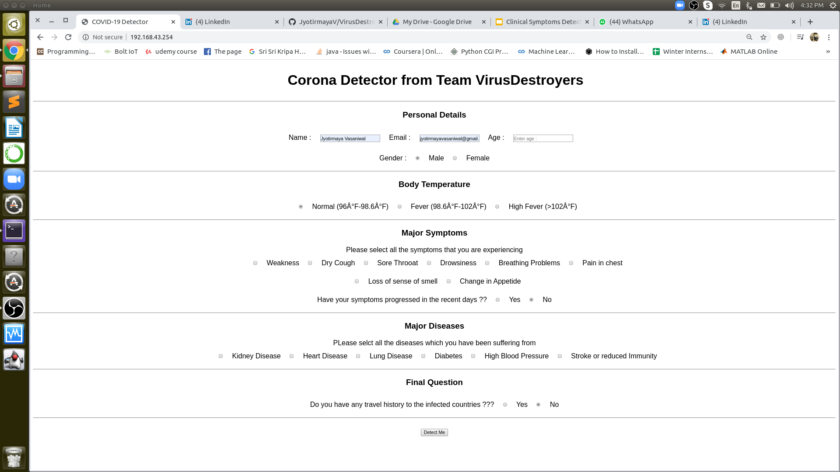
The Home Page

Slide 43
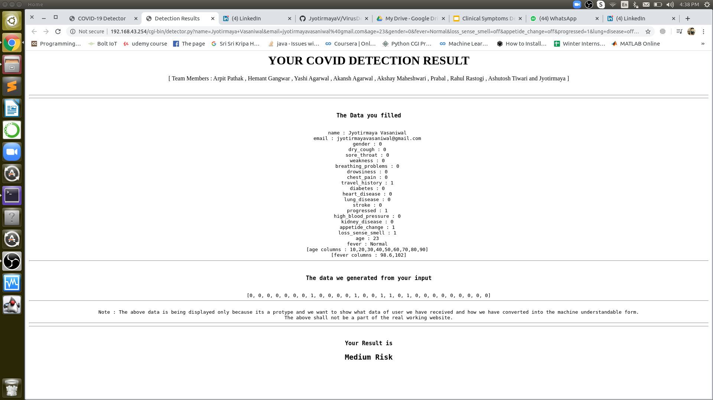
The Prediction Page

Slide 44
How the prototype is working ???
The website is developed using CGI Programming.
The Home Page is built using basic HTML.
The Home page index.html is deployed on the apache web server and transfers its data to detector.py which is our cgi file built using Python.
The detector.py collects all the user entered data and converts it in forms of 0 and 1 so that it can be fed to our trained model for detection.
As specified in the above slides , our model is a deep learning model which we have stored along with the detector.py file in the cgi-bin and using the same for prediction.

Slide 45
TEAM MEMBERS
Akansh Agarwal
Akshay Maheshwari
Arpit Pathak
Ashutosh Tiwari
Hemant Gangwar
Jyotirmaya Vasaniwal
Prabal
Rahul Rastogi
Yashi Agarwal

Slide 46
Future Work

Slide 47
THANK YOU

